Slide 1
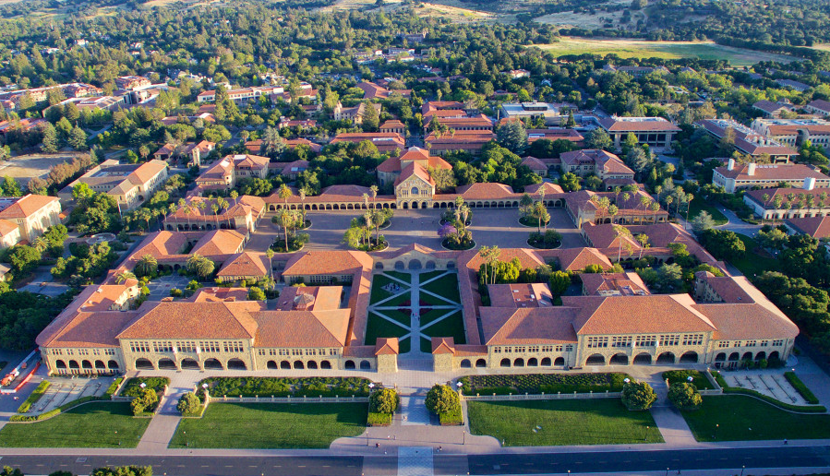
Webinar for Applicants
Stanford University
Sustainable Design & Construction Program
November 8, 2023 @8:00 AM PST
November 8, 2022 @7:00 PM PST

Slide 2
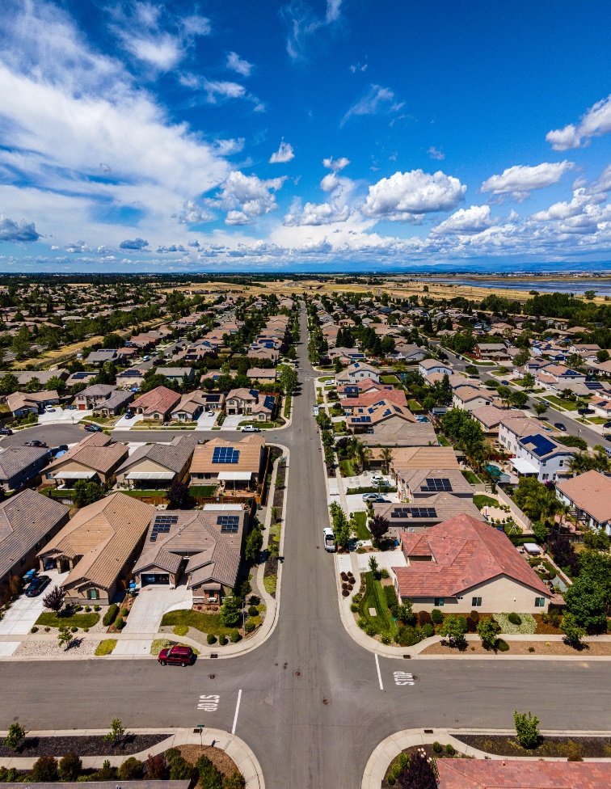
We are Passionate About the Built Environment

Slide 3
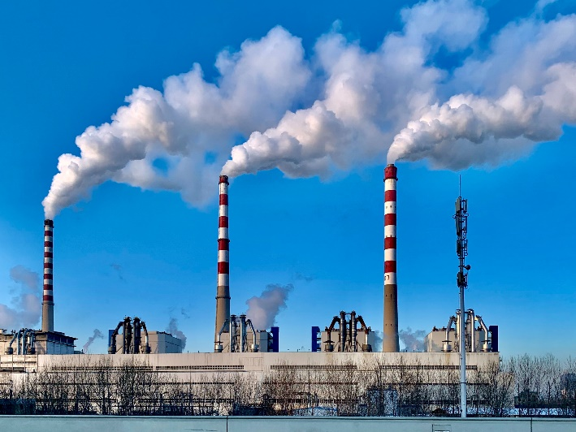
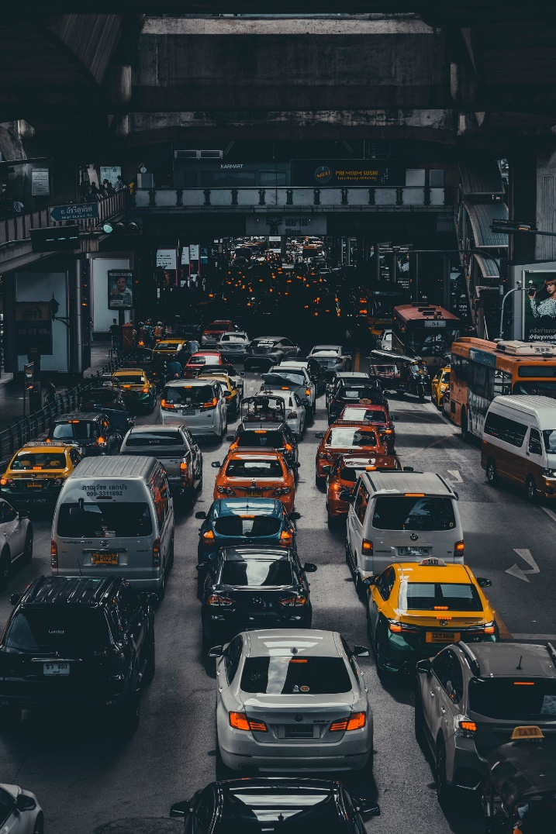
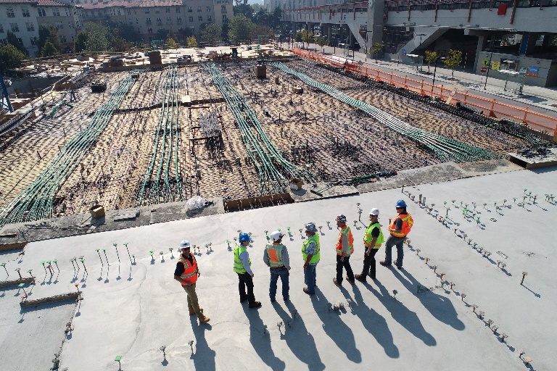
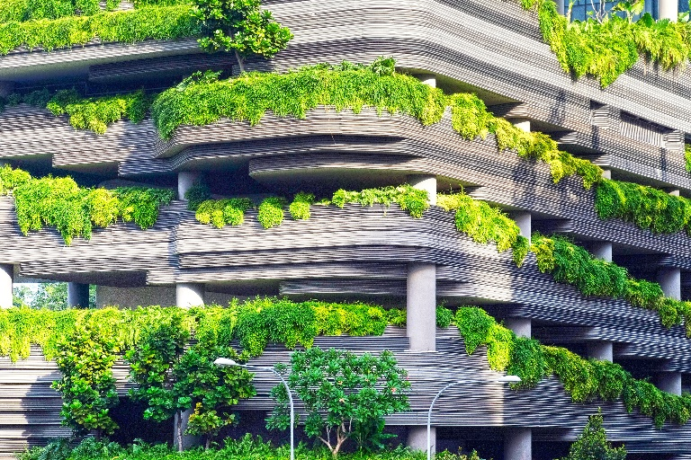
How well is it working? How do we make it better?

Slide 4
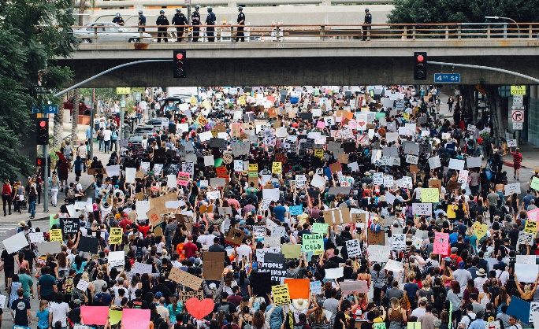
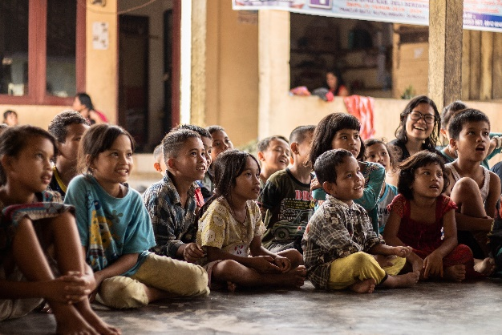
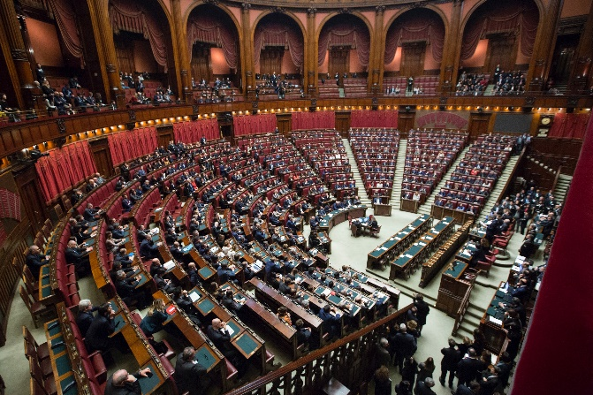
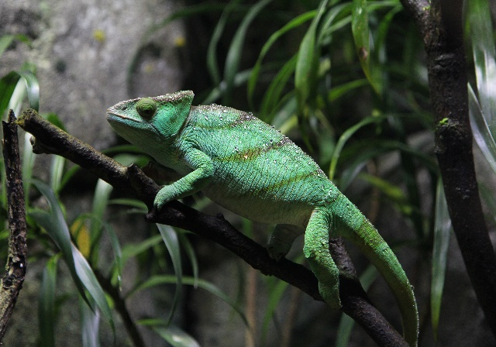
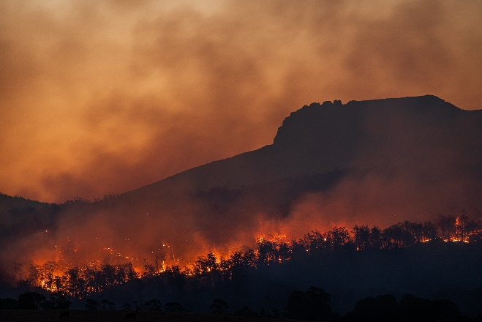
Better for …? Who decides? How do we decide?
The People
Business
The Next Generation
Government
Nature
Planet

Slide 5
How will the SDC program equip you to create a better – high-performing – built environment?
Performance
3 types: economy, environment, equity
4 major types of stakeholders: designers/builders, users, operators, neighbors/community

Slide 6
How will the SDC program equip you to create a better – high-performing – built environment?
Scales
Material ←→ Part ←→ Technical System ←→ Facility ←→ Portfolio ←→ City ←→ Country ←→ World

Slide 7
How will the SDC program equip you to create a better – high-performing – built environment?
People-Process-Technology
Mobile
Cloud
Robotics
AI/ML/GPT
AR/VR/XR
Industrialization
Lean
IPD
...

Slide 8
How will the SDC program equip you to create a better – high-performing – built environment?
Learn to master
2 performance objectives for
2 scales for
2 PPT combinations
Be aware of several additional objectives, scales, and PPT combinations

Slide 9
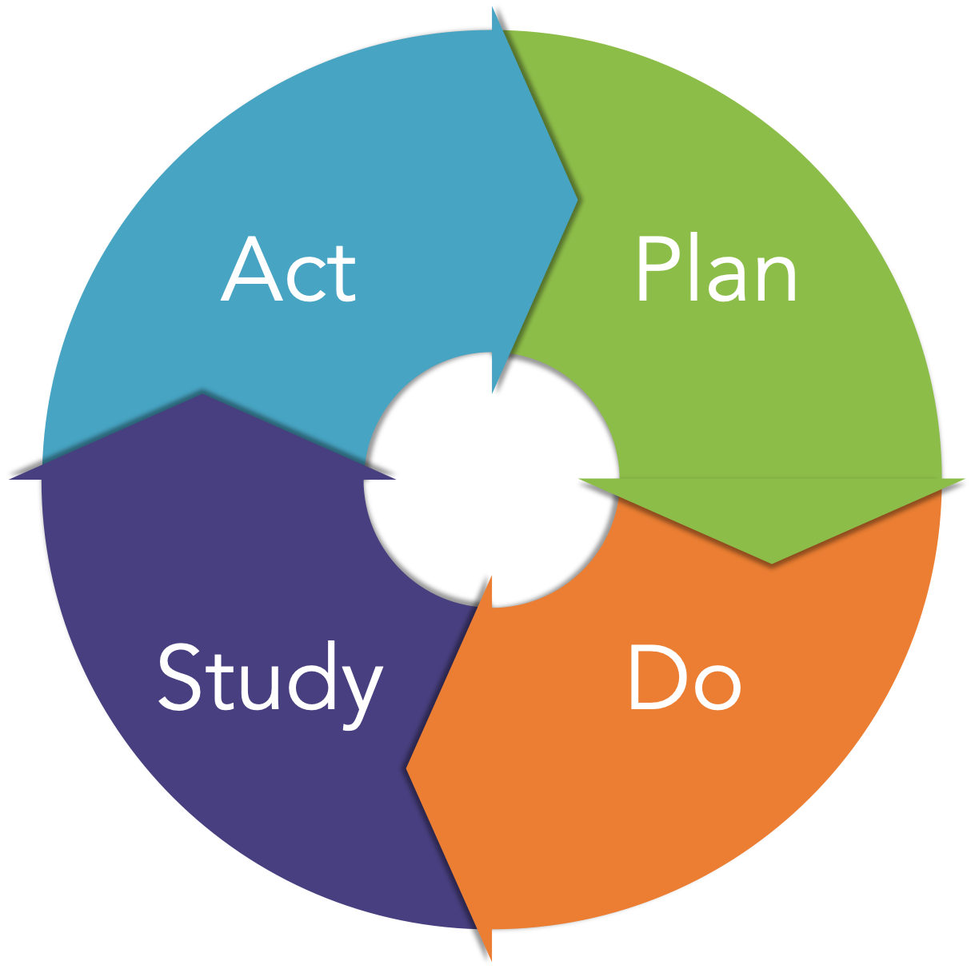
How will the SDC program equip you to create a better – high-performing – built environment?
What does “master” mean?

Slide 10
The four SDC concentrations all focus on achieving
a high-performing built environment
Management
SDC-M
Energy
SDC-E
Sustainable Urban Systems
SDC-SUS
Structures
SDC-S
Notes:
All focus on achieving a high-performing built environment
How the organization is formed depends in large part on the nature of the work being performed
Productivity and effectiveness depend on alignment between:
The nature of work we are doing
How we organize ourselves to accomplish interdependent work
Structure to minimize coordination cost
Processes to enforce needed coordination
We must reach forward into how the work of the program is likely to be done in order to understand how best to organize during planning

Slide 11
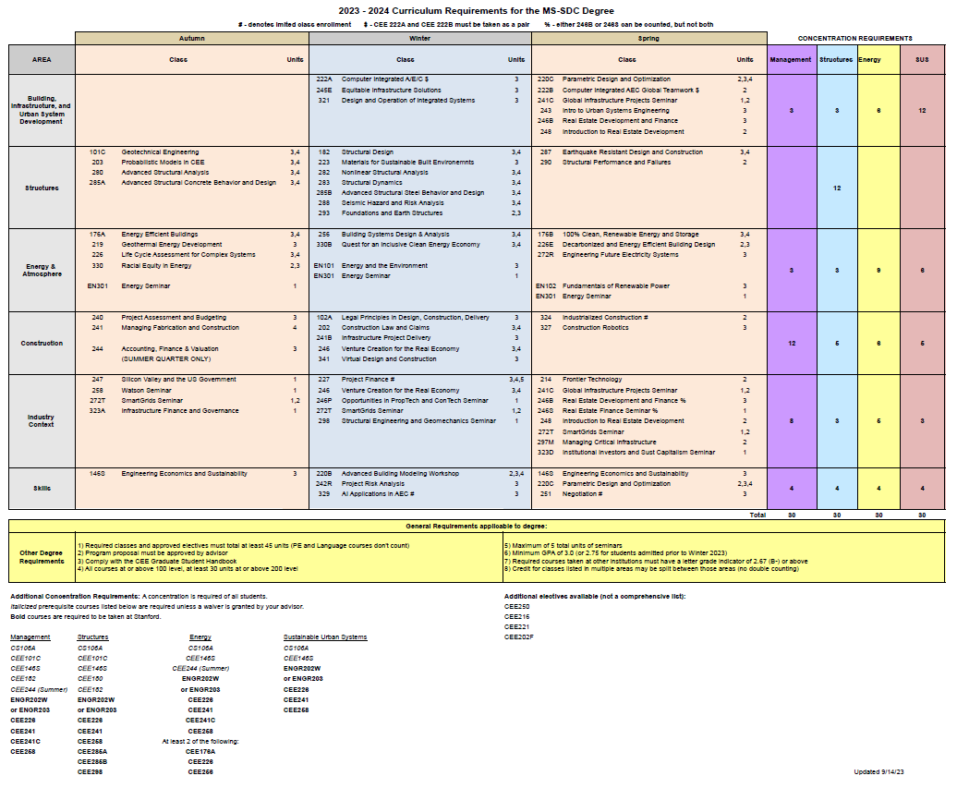
SDC Curriculum Structure
Spring Classes
Management Requirements
Winter Classes
Structures Requirements
Fall Classes
Energy Requirements
SUS Requirements
6 Areas of Academic Emphasis
SDC Track Unit Requirements
Prerequisite and Baseline Requirements

Slide 12
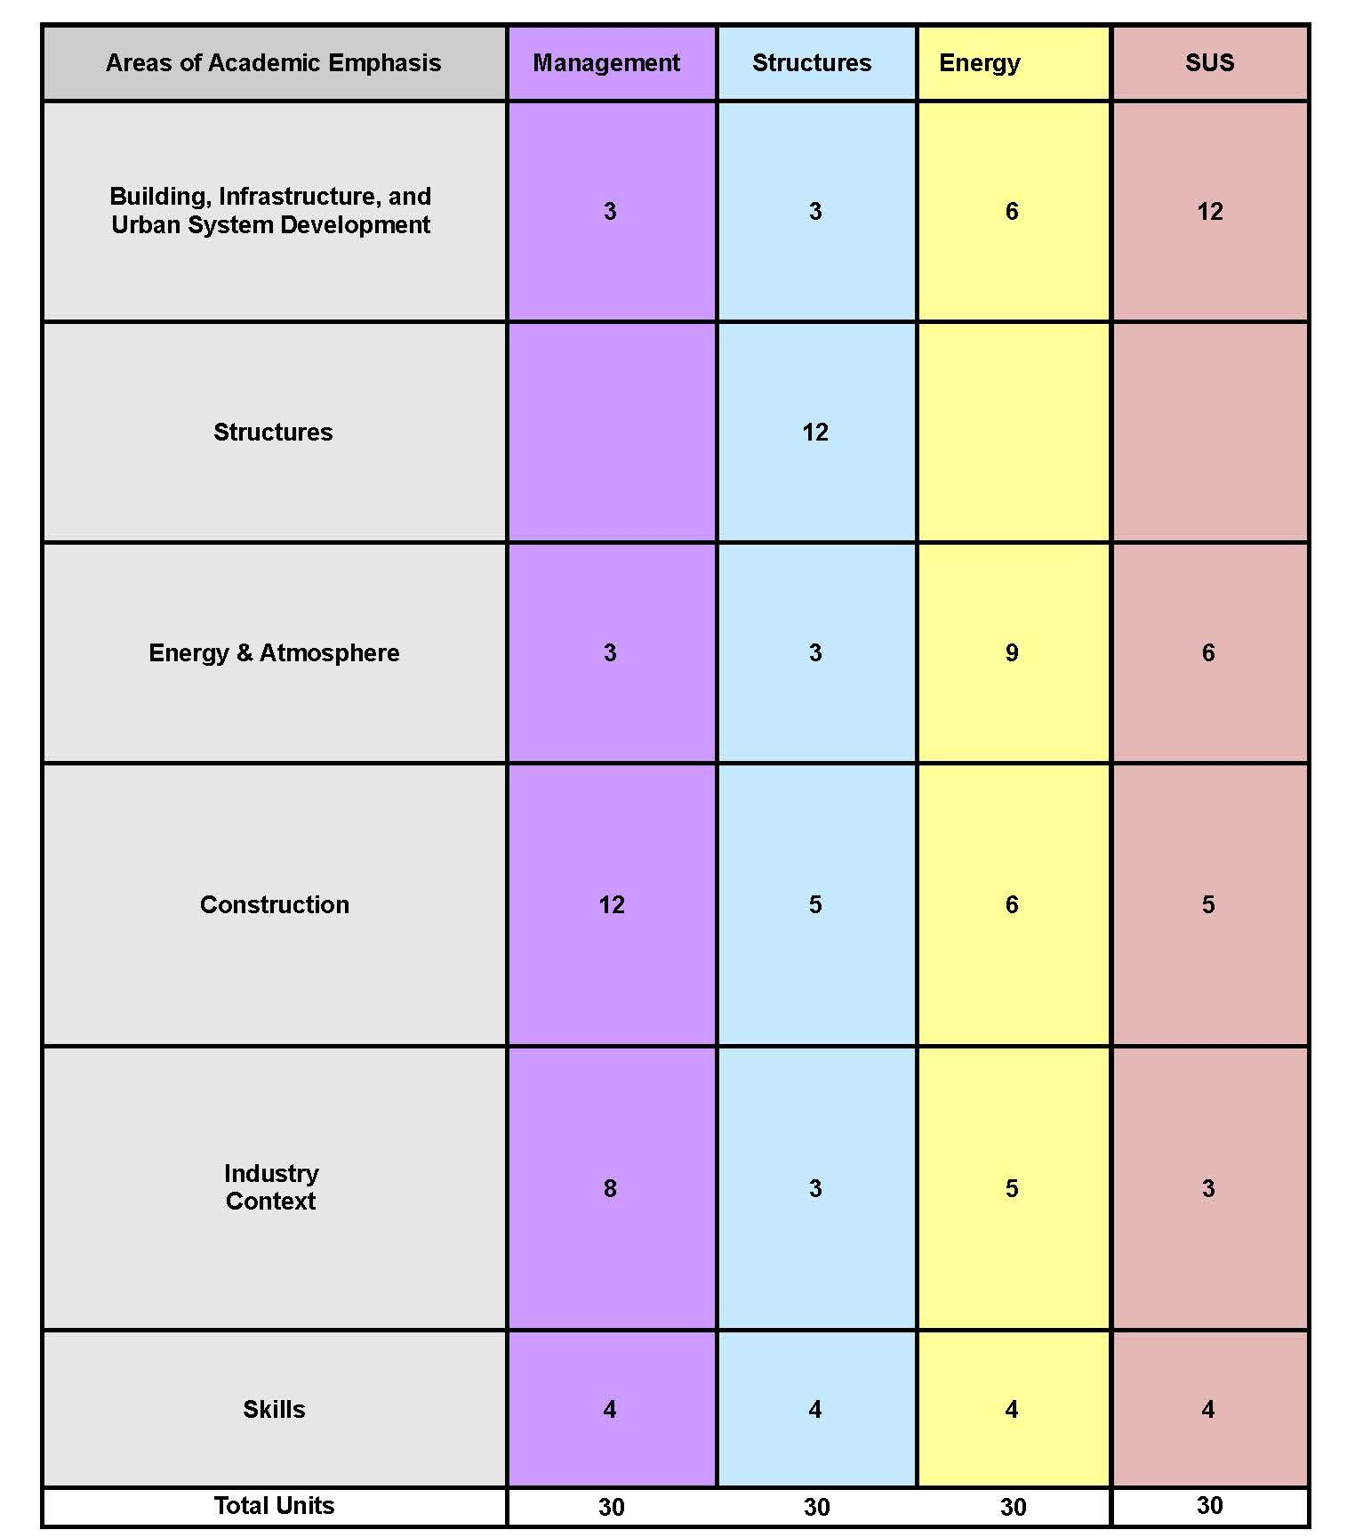
Most SDC courses fall under a specific “Area of Academic Emphasis”
This figure to the left shows the Areas of Academic Emphasis alongside the 4 SDC concentrations
Under each concentration you will see the required number of units that accompany each Area of Academic Emphasis
Example - Under the SDC-SUS concentration, students will take 12 units that fall under Building, Infrastructure, and Urban System Development
Example - With the SDC-Management concentration, students will be taking 12 units in Construction

Slide 13
Diversity in Teaching
25% taught by SDC tenure-line faculty
25% taught by leading practitioners
50% taught by other Stanford faculty
We encourage you to take courses that are taught by different faculty/tenure-line/leading practitioners!
We want you to experience a diversity of concepts and teaching styles in your education here at Stanford.
Notes:
We encourage you (students) to take some courses by each different faculty/tenure-line/leading practitioners. We want diversity of concepts and teaching in your education.

Slide 14
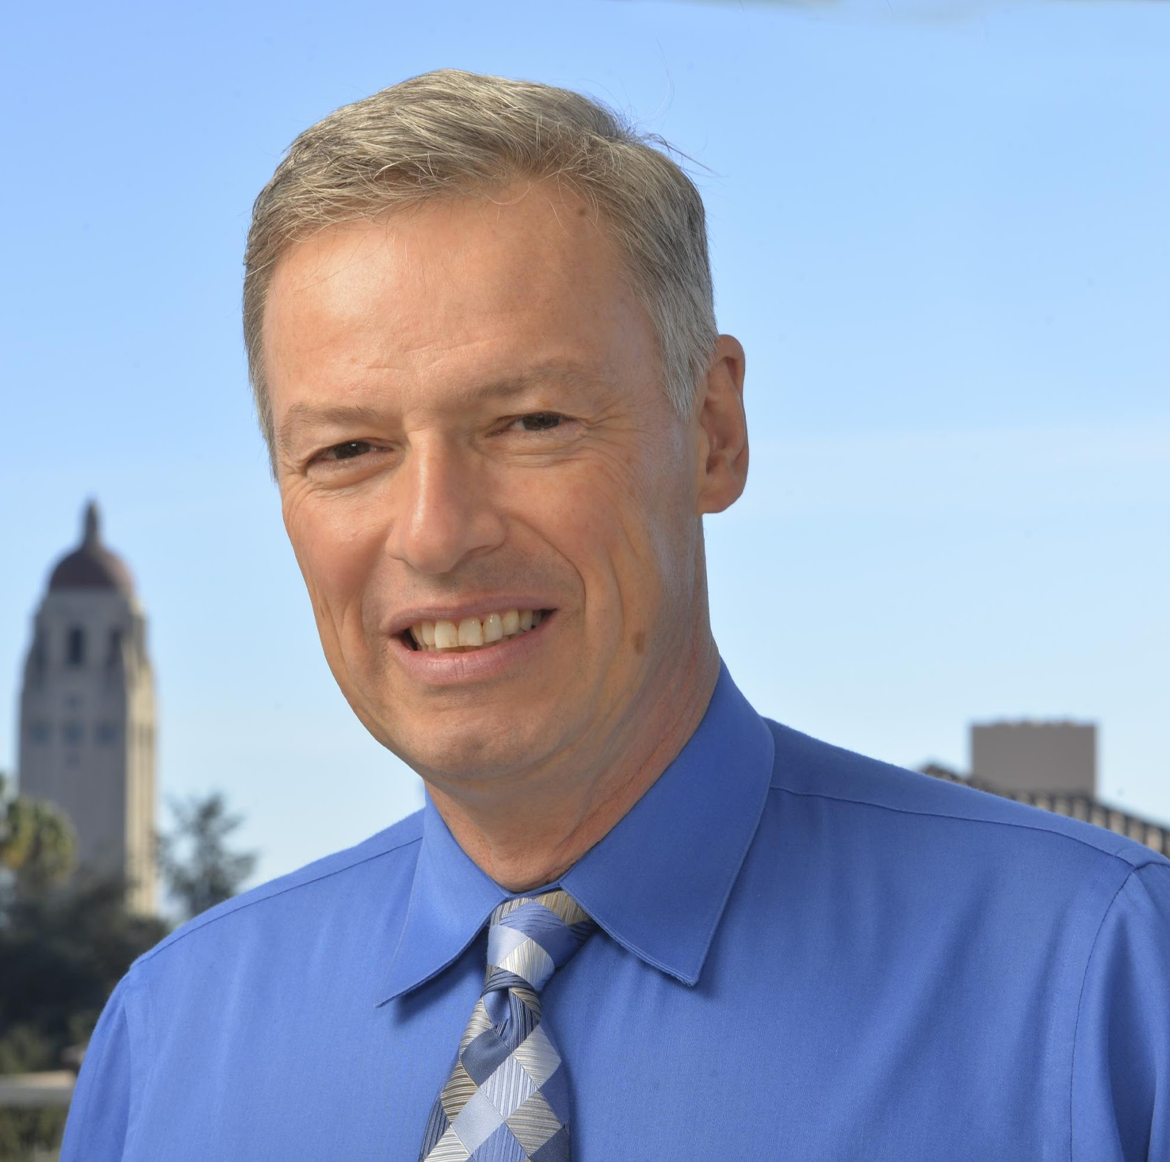
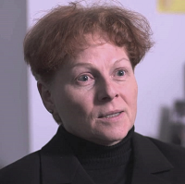
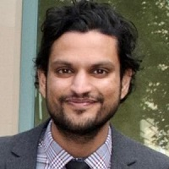
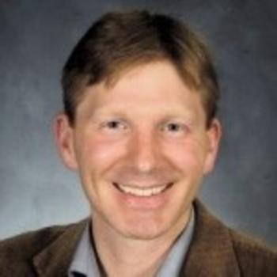
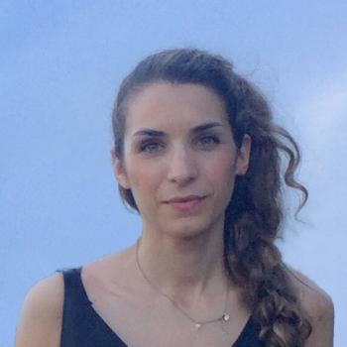
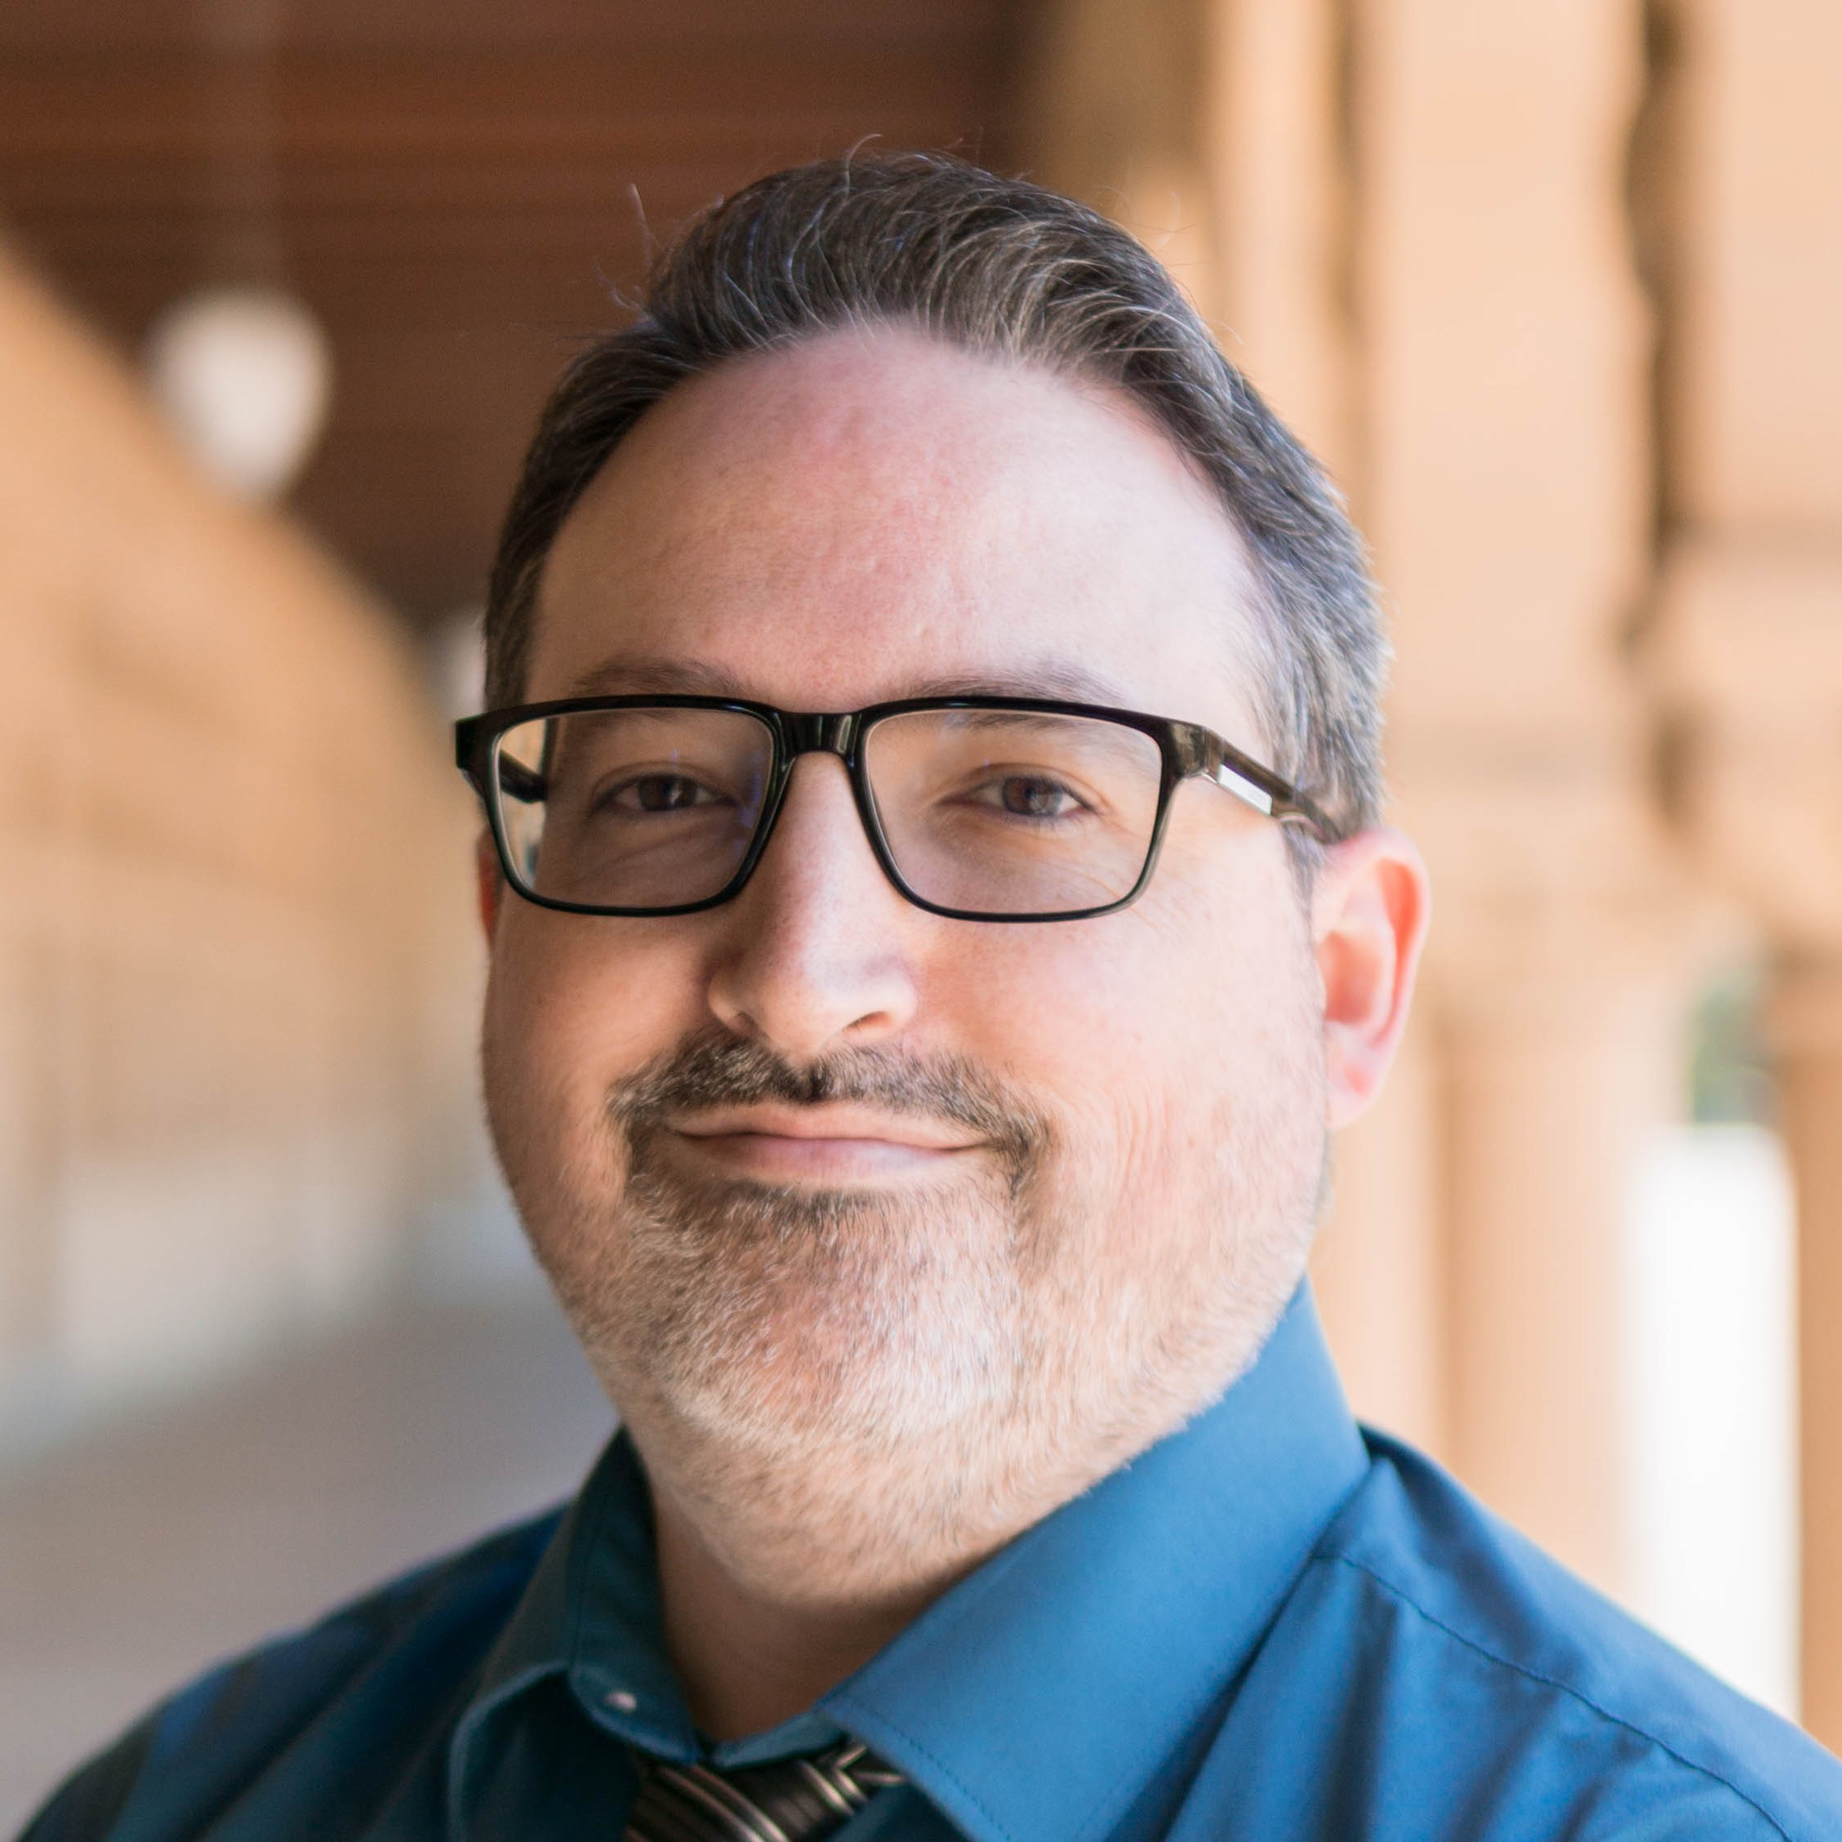
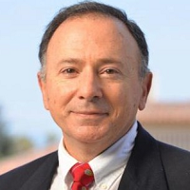
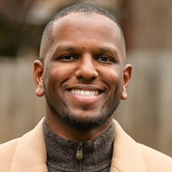
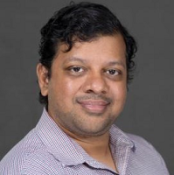
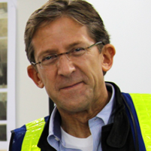
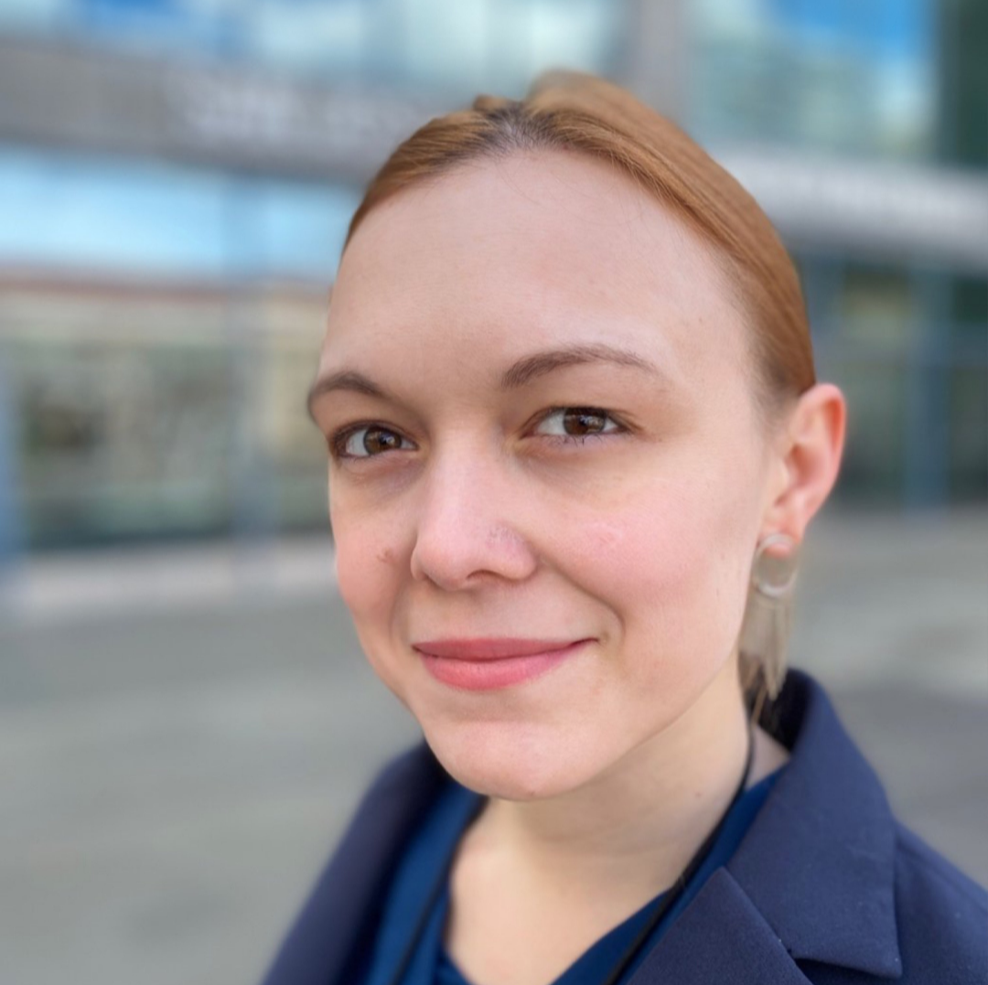
Core Faculty & Staff Members
Martin Fischer
Renate Fruchter
Rishee
Jain
Mike Lepech
Iro
Armeni
Geoff Tuttle
SDC Admin
Tiffany Branum
CIFE Manager
Eduardo Miranda
Khalid Osman
Ram Rajagopal
Brian Sedar

Slide 15
Adjunct Professors & Lecturers
Ashcraft, Howard
Barton, John
Ballati, Deborah
Bazjanac, Vladimir
Birdwell, Jeff
Brosque, Cynthia
Christensen, Stan
Fu, Ernestine
Groves, Robert
Hummel, Holmes
Kam, Calvin
Katz, Glenn
Kinslow, Anthony
Koen, Nelson
Kolderup, Erik
Lessing, Jerker
Lin, Jane
Lyons, Mike
Mokrian, Pedram
Morkos, René
Owens, Dawn
Rumsey, Peter
Savage, Sam
Schwegler, Ben
Subramani, Anand
Tucker, Avram
Zhang, Jiaona

Slide 16
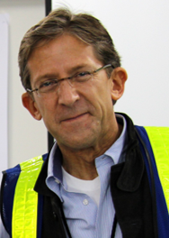
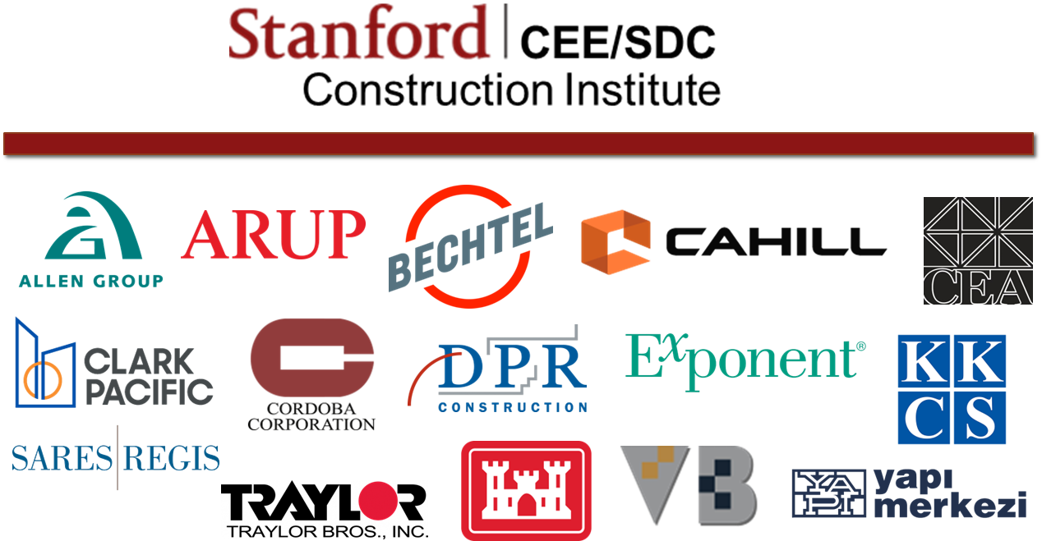
Brian Sedar - Large Infrastructure & Industry
Course Instructor
CEE258 (Fall) – Watson Seminar in Construction Eng. & Management
CEE241B (Winter) – Infrastructure Project Delivery
CEE241C (Spring) – Global Infrastructure Projects Seminar
Exec Director Stanford Construction Institute
Longstanding affiliate organization for industry outreach
Cutting-edge insights from ongoing research
Strong coverage of current/evolving best-practices
Funds MS adjunct faculty and lecturers
Personal Philosophy and Fit to Program
Infrastructure is critical to our economy and quality of life
Returned to US with global experience
Commitment to STEM

Slide 17
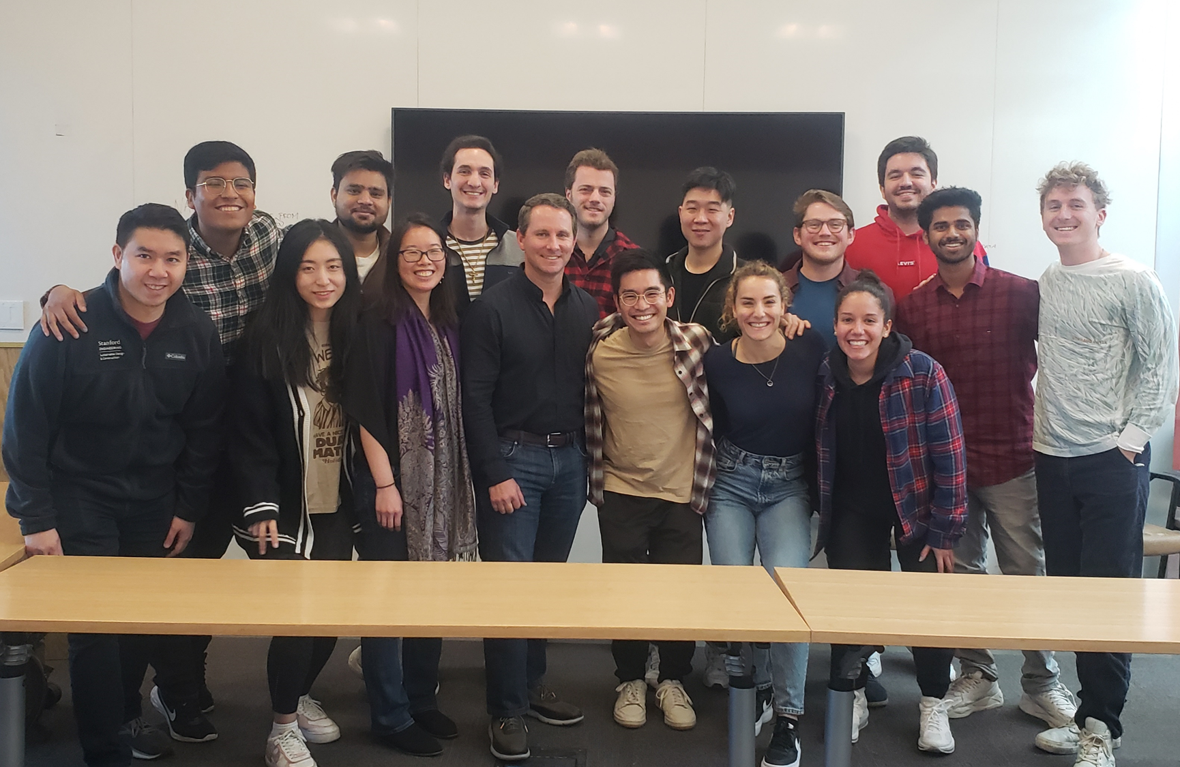
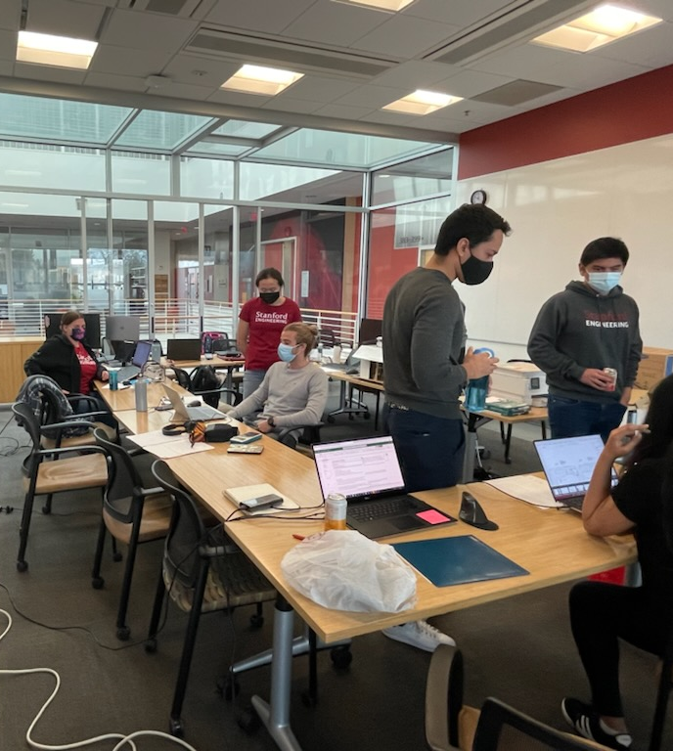
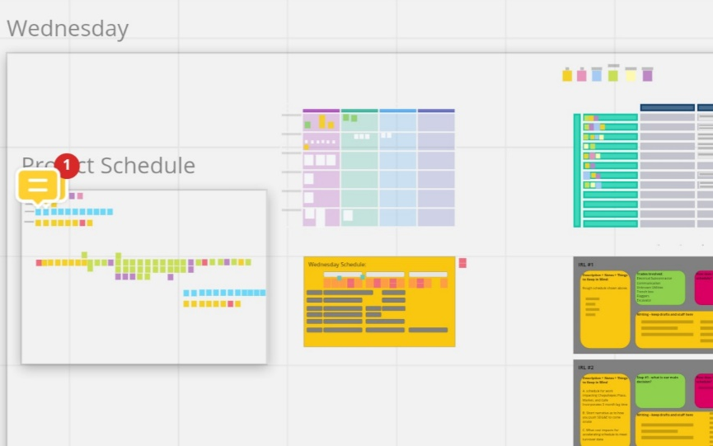
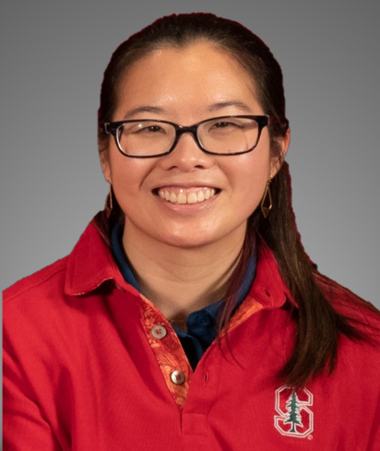
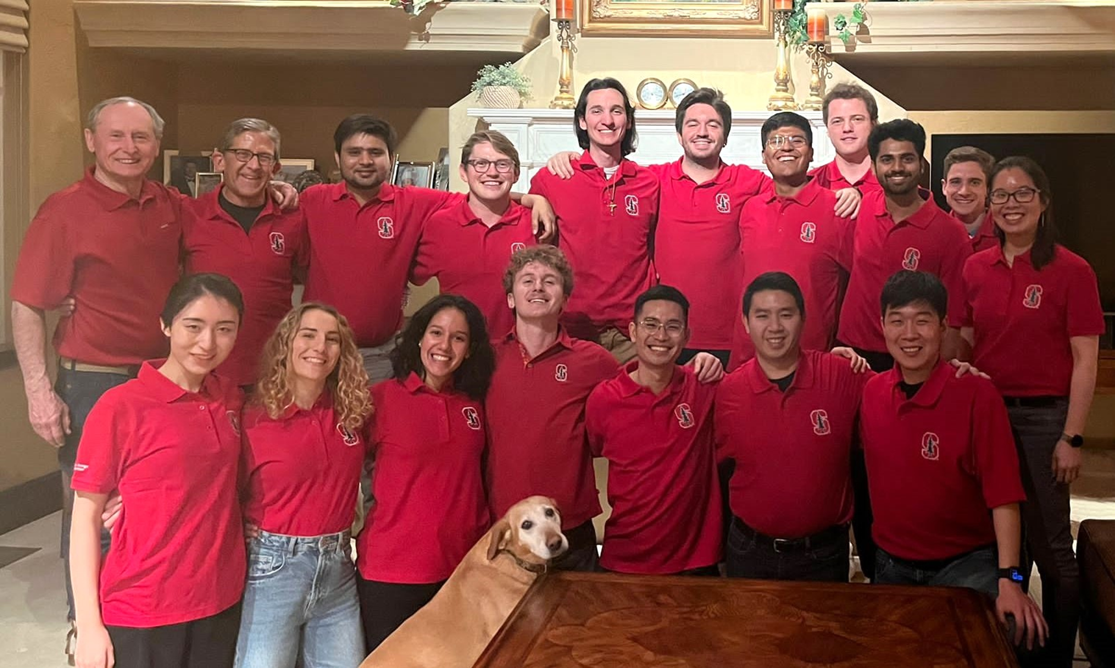
CEE 240 Project
Assessment and Budgeting
Associated Schools of Construction (ASC) Competition
JANE LIN
Stanford ‘12 MS ‘13 (SDC-Structures)
PROJECT MANAGER

Slide 18
Many classes are project-based with mentors from industry
CEE327 Construction Robotics
General Contractors:
Bechtel
DPR
Implenia
Megacentro Peru
MT Højgaard
NCC
Obayashi
Produktiva
Swinerton
Traylor Brothers
Robot Companies:
Boston Dynamics
Canvas
Civ Robotics
Exyn
Hdlab
Hilti
Kewazo
Safeai
Tybot
CEE226 Life Cycle Assessment for Complex Systems
NASA
ARPA-e
Stanford University Office of
Sustainability
Volkswagen Group of America
Google
Ford Motor Company
Kreysler & Associates Fabricators
Cisco
ConXTech
Monterey Bay Aquarium
San Francisco International Airport
ExxonMobil
Clark Pacific
Team Oracle America’s Cup Racing
Webcor
BASF
Guest Speakers:
Annunziata + Desai Advisors
Autodesk
Dusty Robotics
ETH Zurich
TUM (Technical University Munich)
Goldbeck
Mortenson
Shimizu
Stanford Robotics Lab
SVR
Veni
Sustainable Furnishing Council
BONE Structure
Xerxes Companies
Electric Power Research Institute
PPG Industries
Headwaters Materials
Hampton Creek Foods
Beantown Bedding
Steelcase
Containment Solutions
Lafarge Cement
Ashland Chemical
Strongwell Products
Rivian Motors
Bay Area Rapid Transit (BART)
Navitas Capital

Slide 20
Civil and Environmental Engineering is part of two Schools!
School of Engineering
Aeronautics & Astronautics
Bioengineering
Chemical Engineering
Computer Science
Electrical Engineering
Management Science & Engineering
Materials Science & Engineering
Mechanical Engineering
Doerr School of Sustainability
Environmental Behavioral Sciences
Global Environmental Policy
Earth System Science
Oceans
Earth & Planetary Sciences
Geophysics
Energy Science & Engineering
Earth Systems Program (interdisciplinary)
Emmett Interdisciplinary Program in Environment and Resources
Change Leadership for Sustainability Program
Precourt Institute for Energy
Woods Institute for the Environment
Institute for Sustainable Societies
Civil and Environmental Engineering
Atmosphere/Energy
Environmental Engineering
Structural Engineering & Mechanics
Sustainable Design & Construction

Slide 21
Examples of Innovations Pioneered by SDC Faculty
Productivity improvement
CPM
Safety metrics and management
Lean construction
BIM
4D modeling
IFC
MDO
IPD
Project governance
Infrastructure/Institutional Investors
PPP structuring
AI construction scheduling
and much more

Slide 22
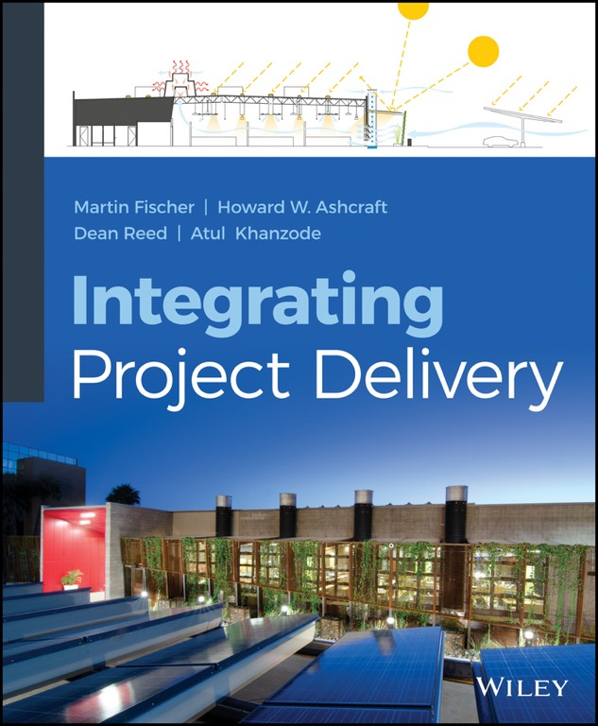
CIFE - Center for Integrated Facility Engineering
100% funded by A/E/C industry
Owner operators
Designers & builders
Technology providers
Timeline
1988 – 2000 (BIM)
2001 – 2010 (VDC)
2011 – present (IPD, HPB)

Slide 23
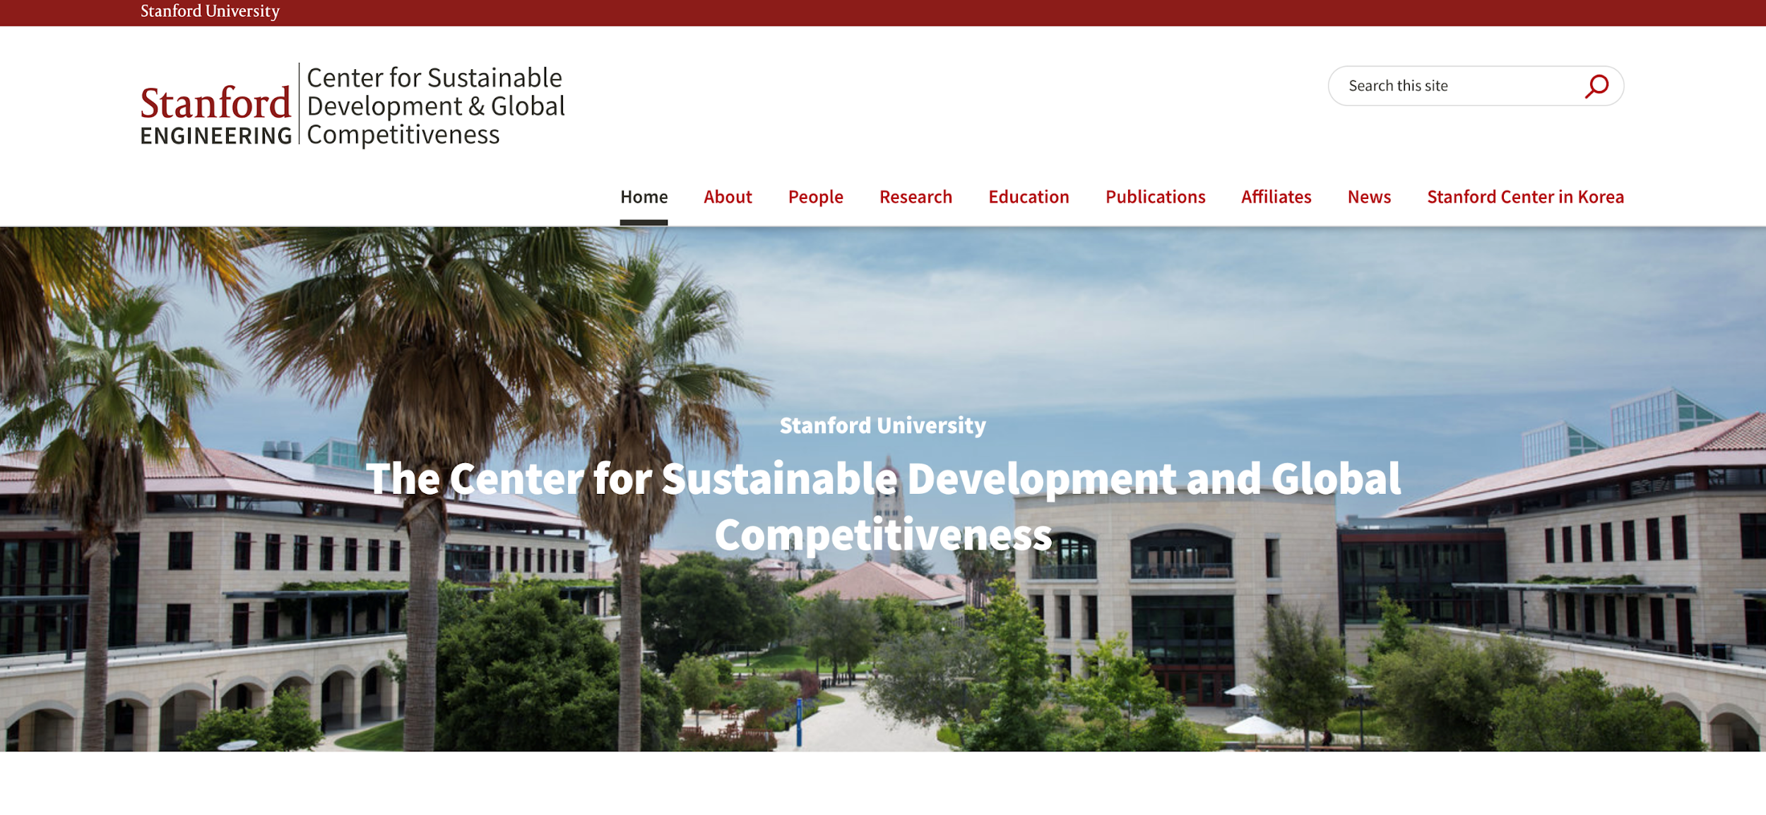

Slide 24
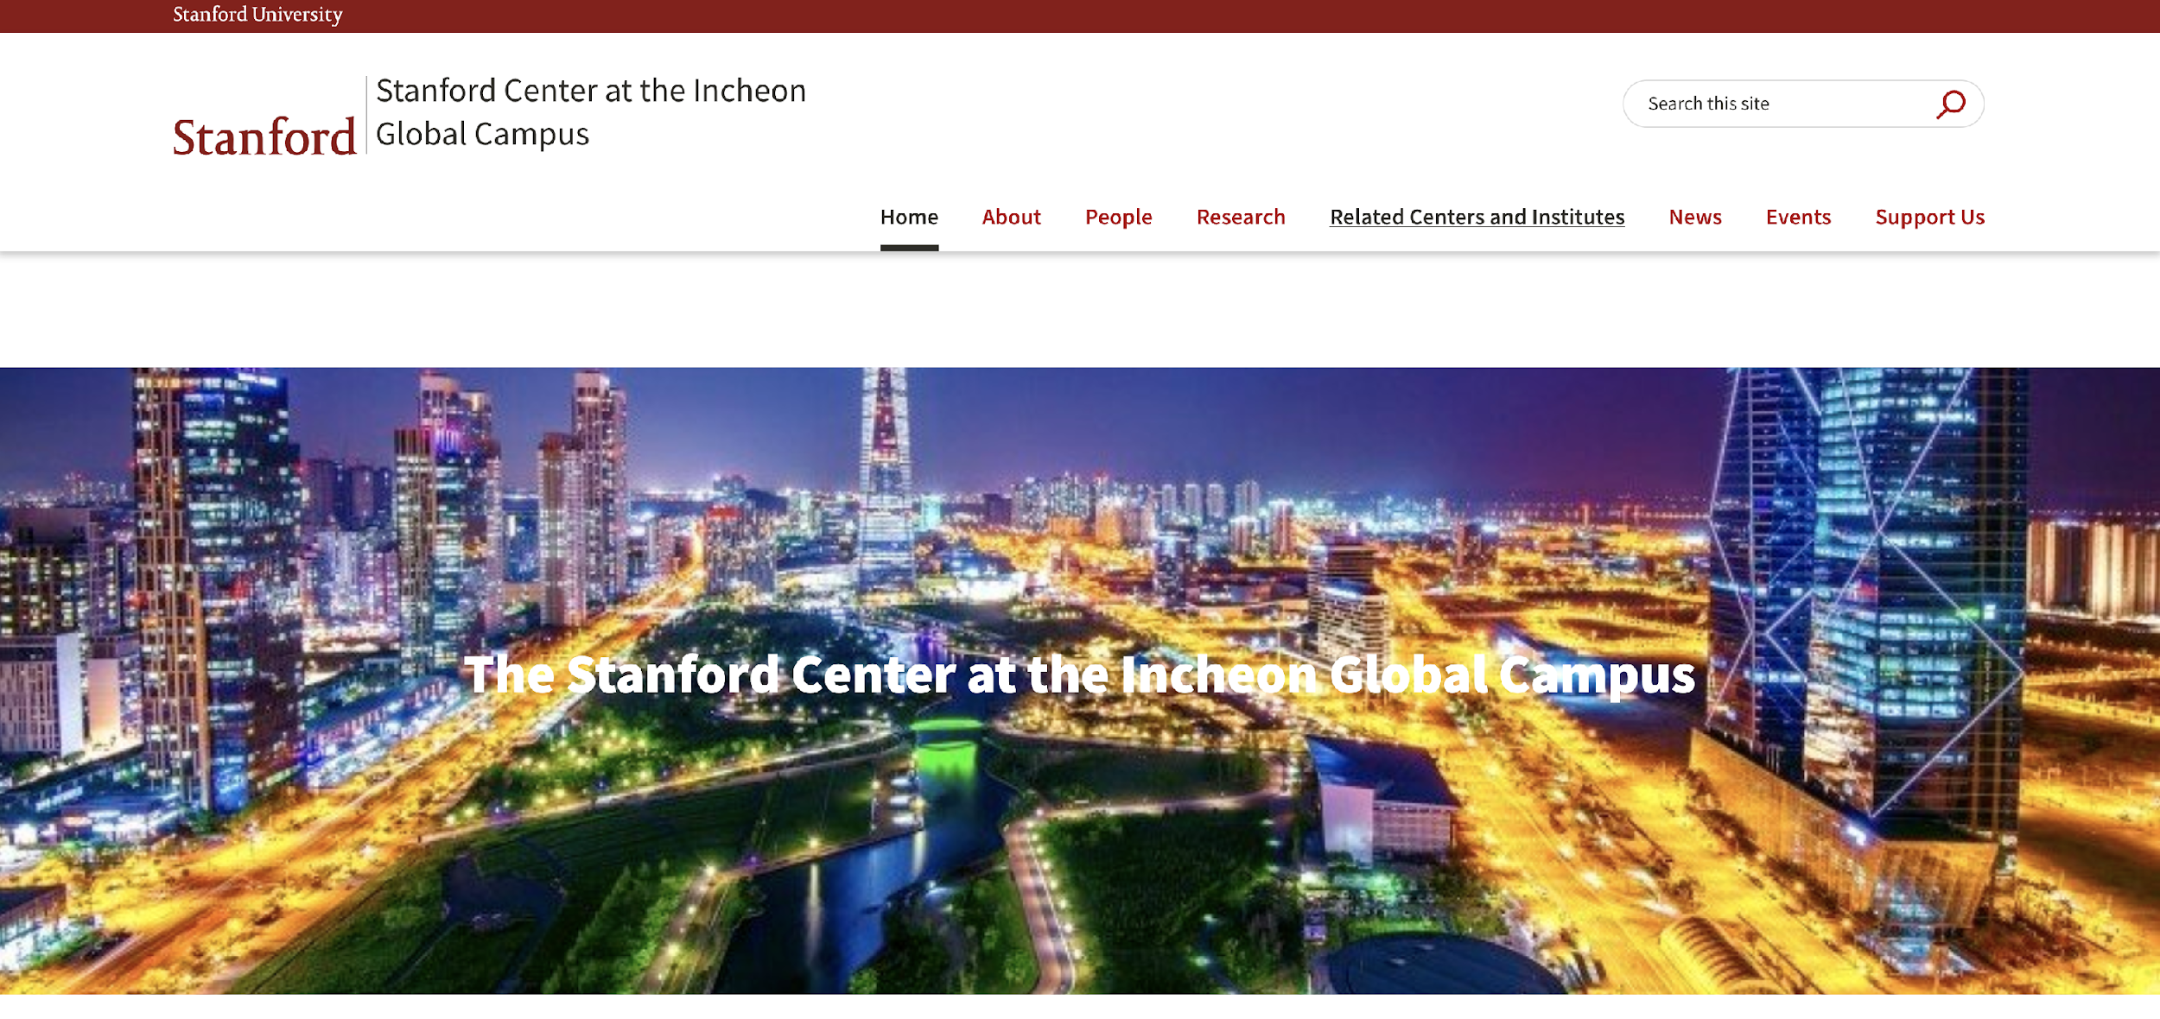

Slide 26
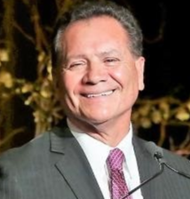
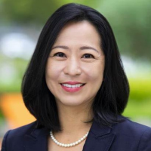
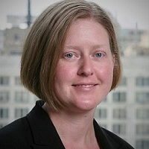
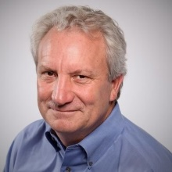
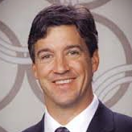
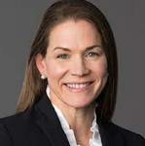
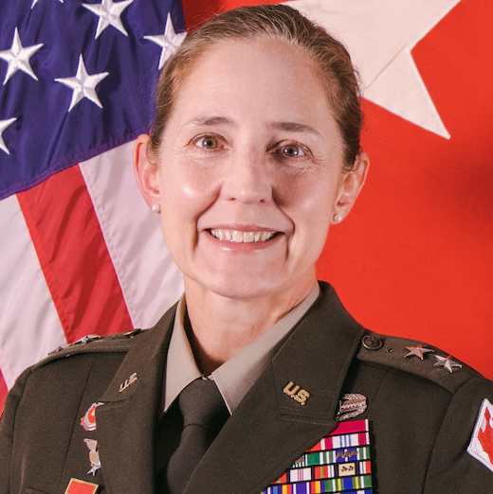
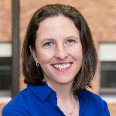
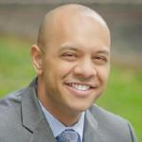
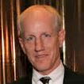
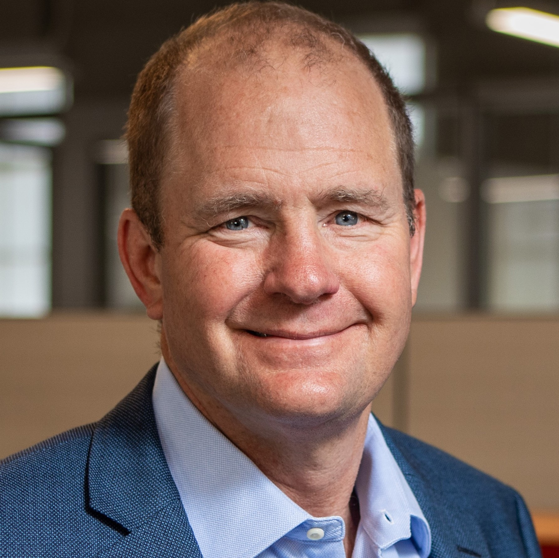
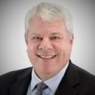
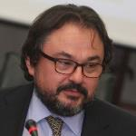
Construction Institute Program Advisory Committee - 2023
Schatzie Allen-Jefferson
President
George Pla
CEO, Pres, Founder
Yayu Lin*
President, Comml
Jenny Buckley
Americas Transport Leader
Eric Lamb*, EVP
Mgmt Cmte Member
Michael Traylor*
Owner & Co-President
Lamis el-Didi
Principal, Constr Practice
Catherine Hunt Ryan*
Pres, Mfg & Tech
M Gen Kim Colloton*
US Army Corps Engr
Kathryn Cahill Thompson*
Chief Executive Officer
Loren Brown, President
Vance Brown Builders
Dev Krishnan
CEO & President
Don Clark*
Co-CEO & Co-Owner
Michael Walton*
Exec Secretary
Constr Employers’ Assn
Başar Arioğlu
Chairman
*Stanford Alums

Slide 27
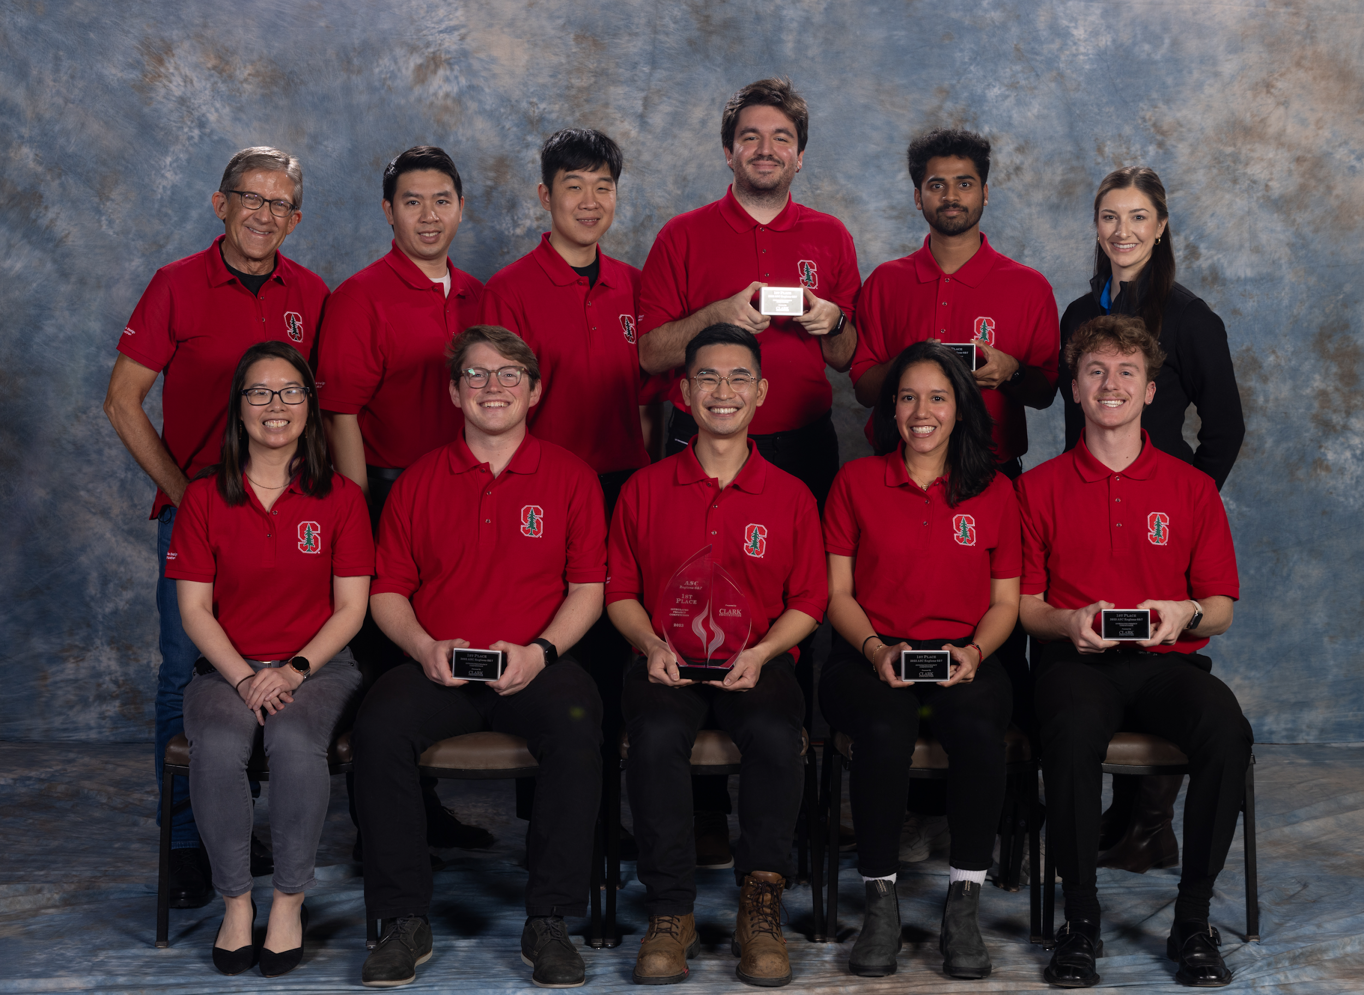
Associated Schools of Construction
7-year winning streak
Open Integrated Project Competition
sponsored by
2023 winning team

Slide 28
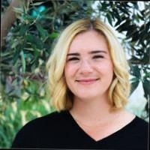
LBE - Leaders of the Built Environment
Build a community within SDC
Generate interest in sustainable engineering from development to delivery
Expose students to industry leaders
Provide opportunities for academic and professional development to positively impact the community
Provide career and scholarship opportunities
Host fundraising and philanthropy events (golf tournament, Habitat for Humanity, etc.)
Happy hours and fun events
Michelle Filanc
mfilanc@stanford.edu
Laura Vanderweyen
vanderk@stanford.edu
LBE Events – Smores Bonfire Night
Notes:
Leaders of the Built Environment (LBE) represents students in the Sustainable Design and Construction program

Slide 29
Honor Code
The Honor Code is an undertaking of the Stanford academic community, individually and collectively. Its purpose is to uphold a culture of academic honesty.
Students will support this culture of academic honesty by neither giving nor accepting unpermitted academic aid in any work that serves as a component of grading or evaluation, including assignments, examinations, and research.
Instructors will support this culture of academic honesty by providing clear guidance, both in their course syllabi and in response to student questions, on what constitutes permitted and unpermitted aid. Instructors will also not take unusual or unreasonable precautions to prevent academic dishonesty.
Students and instructors will also cultivate an environment conducive to academic integrity. While instructors alone set academic requirements, the Honor Code is a community undertaking that requires students and instructors to work together to ensure conditions that support academic integrity.
https://communitystandards.stanford.edu/policies-guidance/honor-code
Violations of the Honor Code
Examples of conduct that have been regarded as being in violation of the Honor Code include:
Copying from another’s examination paper or allowing another to copy from one’s own paper
Unpermitted collaboration
Plagiarism
Revising and resubmitting a quiz or exam for regrading, without the instructor’s knowledge and consent
Giving or receiving unpermitted aid on a take-home examination
Representing as one’s own work the work of another
Giving or receiving aid on an academic assignment under circumstances in which a reasonable person should have known that such aid was not permitted

Slide 31
Inspire Others & Change the World
At Stanford, you will gain the knowledge, skills and confidence to really make a difference in the world.
We look forward to reading your application!

